Slide 1
AIM6140: Health Informatics
Health data life cycle

Slide 2
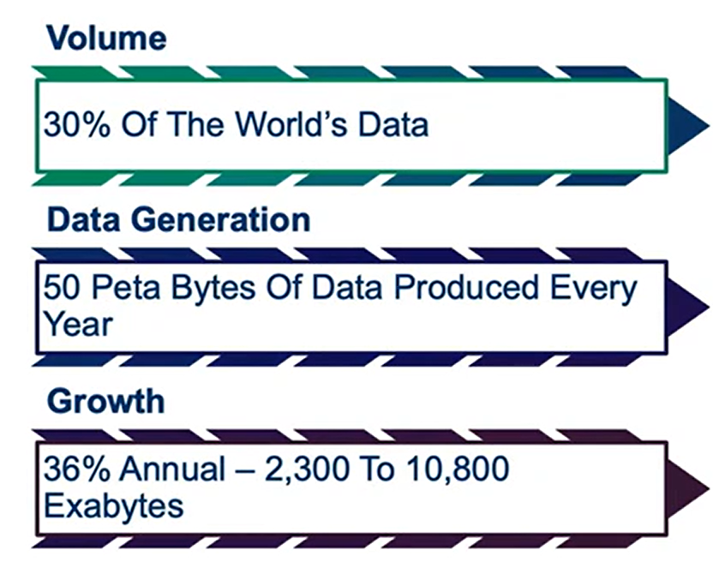
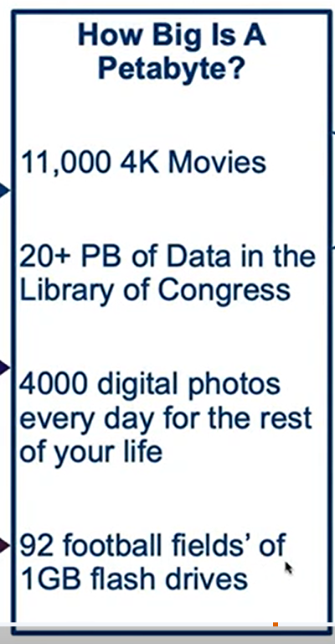
Healthcare digitized data volume

Slide 3
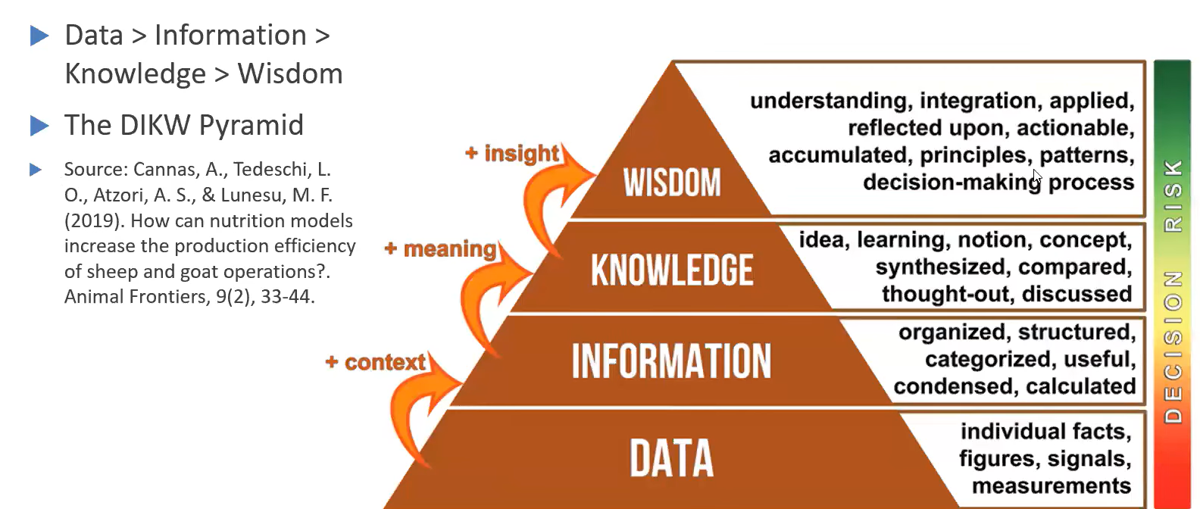
DIKW Pyramid

Slide 4
THE LIFE OF DATA
A dataset has a longer lifespan than the research project that creates it
Data can be used and re-used for future research, if:
  shared
  managed well
  properly preserved
  made available

Slide 5
GOOD MANAGEMENT OF DATA
good research
high quality data
data can be understood and used now and in future
data can be shared and reused
needs to be planned
needs to be specific for purpose

Slide 6
PLAN YOUR DATA MANAGEMENT
plan data management early
assign roles and responsibilities
design data management according to needs and purpose of research
implement and review data management throughout research

Slide 7
DATA POLICY CONTEXT
Increasingly research funders require planning for data management and data sharing
Examples:
  National Science Foundation
  various research councils

Slide 8
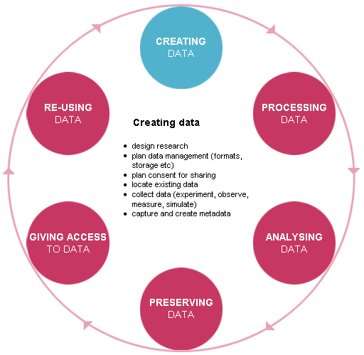
DATA LIFECYCLE

Slide 9
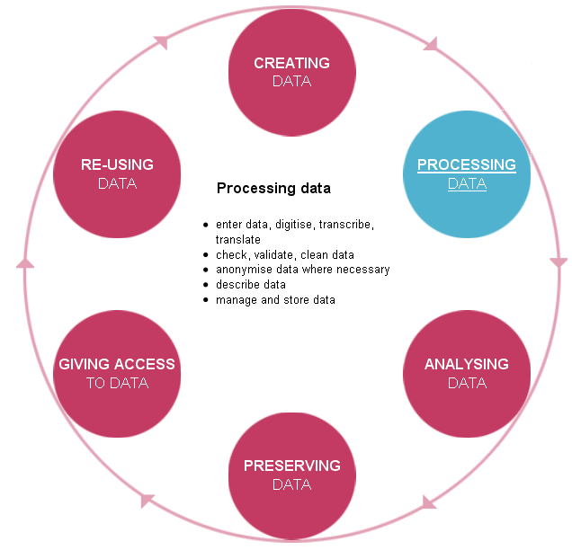
DATA LIFECYCLE

Slide 10
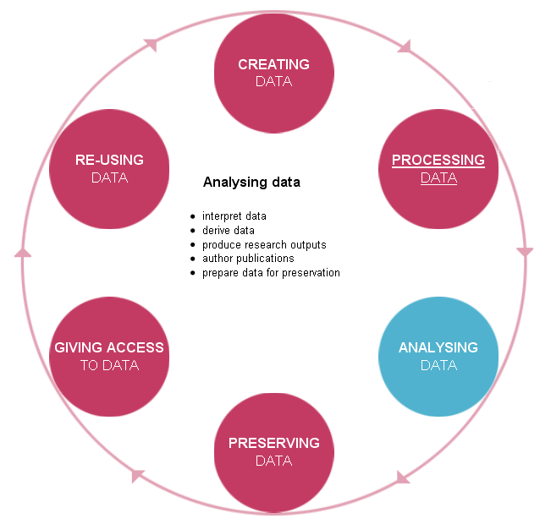
DATA LIFECYCLE

Slide 11
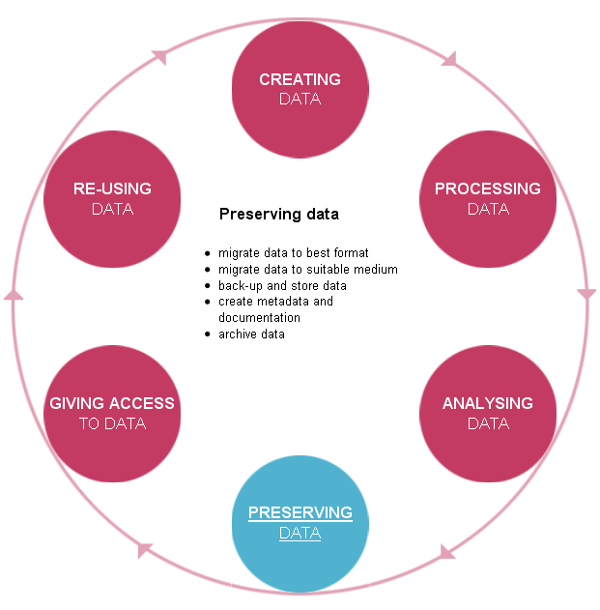
DATA LIFECYCLE

Slide 12
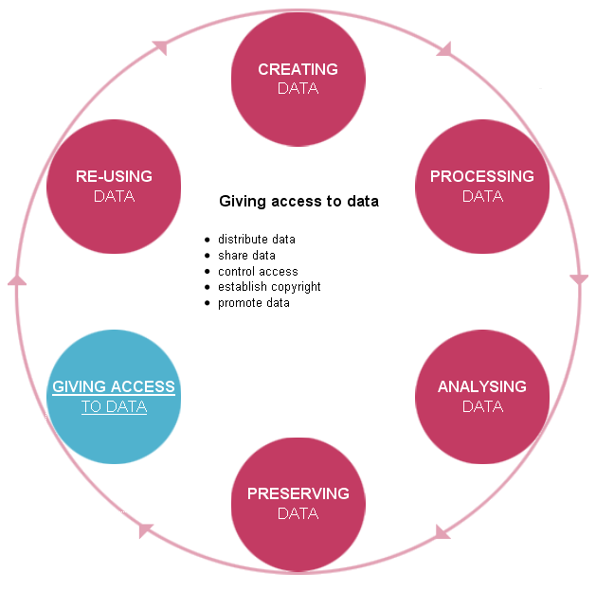
DATA LIFECYCLE

Slide 13
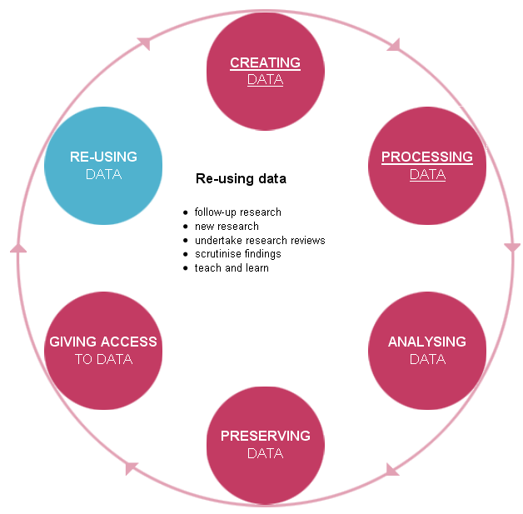
DATA LIFECYCLE

Slide 14
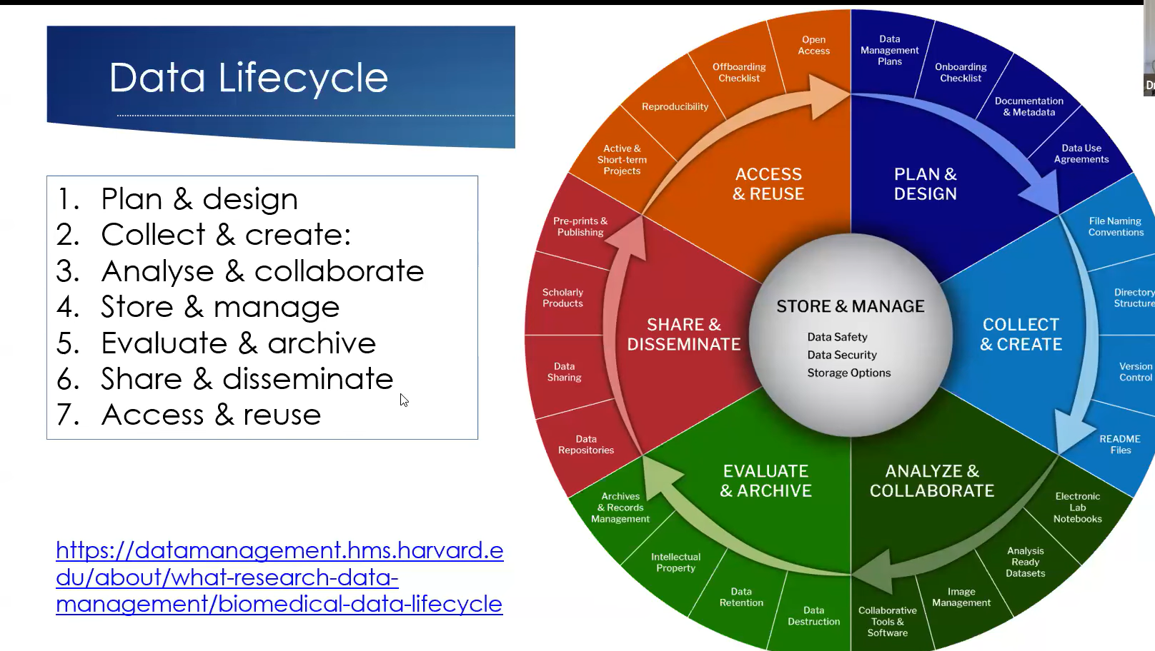
Health Data Lifecycle

